Slide 1
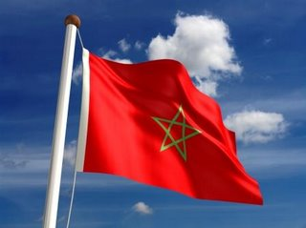
Biography of Tahar Ben Jelloun and Morocco Snapshot

Slide 2
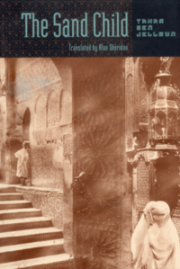
The Sand Child Themes
Surrealism
Poetic, lyrical language
Unreliable narrators
Gender
Sexuality/Dysfunction
Oral Tradition
Importance of storytelling
Multiply storytellers

Slide 3
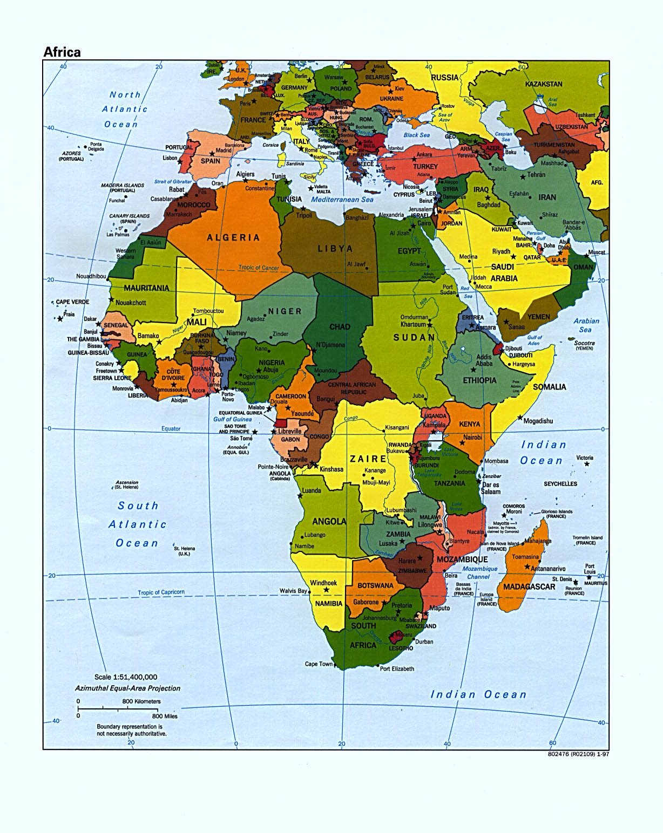
Morocco

Slide 4
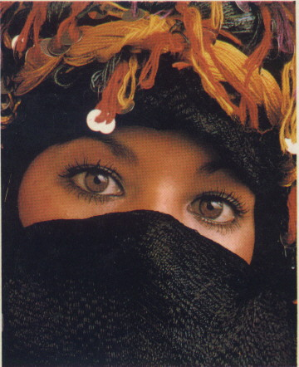
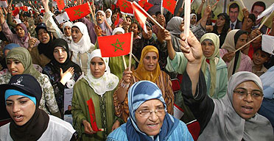
Language
Arabic
French
Derija

Slide 5
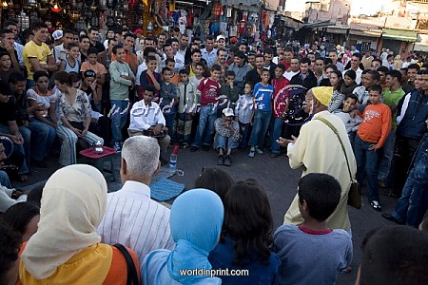
Moroccan Tradition
Greetings
Shaking hands
Gestures
Pointing
Eating
Crossing legs
Dating and Marriage
Inheritance Law
Role of Women

Slide 6
Politics
Islamic, Democratic, Social Constitutional Monarchy
International and Regional Organizations
Constitution
Equal Rights to education and employment
Political parties
Right to strike
French Colonization

Slide 7
Interactive Oral: Discussion
Topics
Inheritance Law
Moroccan Culture vs. American Culture
Women in Morocco vs. Women in Western Society
Time Period and Place: Post-Colonial Morocco
Predictions for Book

Slide 8
Biography of Tahar Ben Jelloun

Slide 9
Early Years & Education
Born in Fez, Morocco in 1944
Attended University in Morocco and completed a bachelors in 1971.
Immigrated to France in 1971 and studied at the University of Paris. Earned a PhD in Psychiatric Social Work in 1975

Slide 10
Moroccan Culture
Situations unfamiliar to his audience may be difficult to relate to; therefore his stories may lose some legitimacy. An obvious example is that of pretending that one’s daughter is a son in order to preserve one’s property and maintain one’s prestige. Although this probably seems foreign to most, one could argue that the themes of gender identity and the way in which it relates to power and societal structure are pervasive throughout all cultures. Not only does Ben Jelloun write about Moroccan situations that may be seen by others as nonsensical and/or uncivilized, but he openly criticizes them.

Slide 11
Surrealism
It has been said that Ben Jelloun is primarily a poet; therefore his writing style resembles that of a poet. His work is concise yet full of poetic images and lyrical language. Ben Jelloun is a story teller, but he also allows the reader to become involved in his magical world. Dream-like states, hallucinations, and allusions to Andre Breton and the exquisite corpse each give Ben Jelloun’s work a magical intoxicated quality. Unreliable narrators and different points of view of the same story add to the mystical atmosphere as well.

Slide 12
Sexuality/Dysfunction
Having received his doctorate for the relationship between sexuality and immigration into France of North African male workers, Ben Jelloun also is quite interested in sexuality and dysfunction. The majority of his works have the protagonist suffering from some sort of dysfunction.

Slide 13
Works Cited
"FOCUS on MOROCCO - General Information." Focus Mediterranean Magazine | Mediterranean Culture | Focusmm.com. Web. 14 Aug. 2011. <http://www.focusmm.com/morocco/mo_giam n.htm>.
"Jelloun." Emory University---English Department "Where Courageous Inquiry Leads“ Web. 14 Aug. 2011. <http://english.emory.edu/Bahri/Jelloun.html>.

